Slide 1
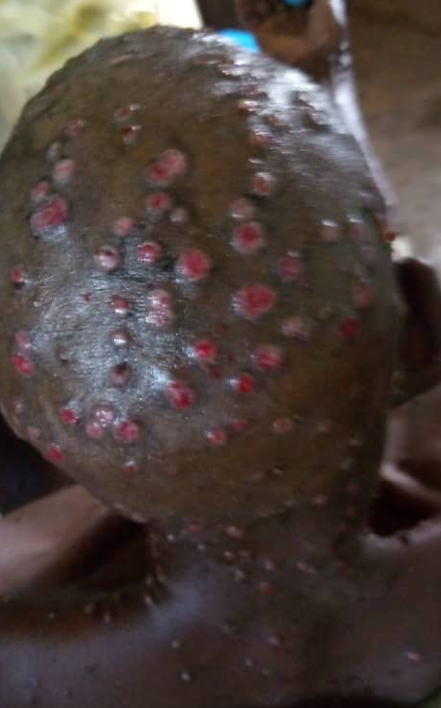
WHO (SAGE) recommendations on mpox vaccines & immunization

Slide 2
Mpox vaccines and immunization recommendations
In response to the global mpox outbreak, interim guidance on mpox vaccines and immunization was endorsed by SAGE and published in November 2022
In the last year, additional epidemiological data has been obtained from the African setting
New information has become available regarding the safety and vaccine effectiveness of MVA-BN
SAGE considered this for the 2024 updated mpox vaccine and immunization recommendations
These updated mpox vaccine recommendations will be published in an upcoming position paper which will combine SAGE endorsed smallpox vaccine recommendations developed in October 2023

Slide 3
Recommendation 1: mpox outbreak response¹
Vaccination is recommended for persons at high risk of exposure to mpox in an outbreak. The identification of populations at risk of exposure is limited in some settings by currently available epidemiological data. In studies involving men who have sex with men, pre-exposure vaccination with one or two doses of smallpox/mpox vaccine was demonstrated to be effective against mpox. Effectiveness of post-exposure vaccination is less certain, which may be linked to the predominantly sexual mode of transmission in available studies. To allow the greatest flexibility with respect to local risk assessment, varied modes of transmission and response options, populations to consider for vaccination may include:
based on local epidemiology, members of a geographically defined area or community (e.g. village), including children, with a documented high risk of exposure to mpox;
sex workers; gay, bisexual or other men who have sex with men (MSM) with multiple sexual partners; or other individuals with multiple casual sexual partners;
health workers at risk of repeated exposure; clinical laboratory and health care personnel performing diagnostic testing for mpox or providing care, and outbreak response team members (as designated by national public health authorities).
contacts of persons with mpox, ideally within four days of first exposure.² Contacts may include children, others in the household or in congregate settings (such as prisons, schools, health facilities or residential facilities)
1. Outbreak definition: occurrence of two or more laboratory confirmed (or one laboratory confirmed and one or more epidemiologically linked cases) of mpox in nationally or locally defined geographic areas
2. Criteria to define risk of exposure in this context include e.g. direct skin-to skin physical contact, contact with contaminated materials such as clothes or bedding. Vaccination ideally up to 14 days in the absence of symptoms.

Slide 4
Recommendation 2: preventive use of mpox vaccines (outside of an outbreak)
Primary preventive vaccination is recommended for:​
Laboratory personnel working with orthopoxviruses
The duration of protection of mpox vaccines is not fully characterized. Therefore, periodic revaccination should be considered for individuals who are at high risk of exposure to more virulent orthopoxviruses (e.g. variola virus, monkeypox virus, cowpox virus, vaccinia virus and/or others as appropriate). This may be as often as every 2 to 5 years for laboratory workers at highest risk of exposure, as practiced in the two authorized WHO Collaborating Centres for variola virus research, or less frequently in other settings, according to the latest available information on duration of protection for the vaccines used.​

Slide 5
Recommendation 3: choice of vaccines for immunocompetent non-pregnant individuals
WHO recommends that for immunocompetent non-pregnant individuals, non-replicating vaccine (MVA-BN), minimally replicating vaccines (LC16-KMB), replicating cell-culture derived vaccinia-based vaccines (e.g. ACAM2000) or equivalent vaccines that meet WHO standards for quality, are appropriate for use.
Specific considerations, including potential off-label use, apply as to vaccine choice for special population groups (see recommendation on vaccine choice for special populations).

Slide 6
Recommendation 4: choice of vaccine for special populations - infants, children and adolescents
For infants, children and adolescents, where consideration is given to vaccination, non-replicating (MVA-BN) or minimally replicating (LC16-KMB) vaccines may be used.
LC16-KMB is approved for use in children in Japan. While MVA-BN is currently not licensed for persons under 18 years old, this vaccine may be used in infants, children and adolescents when the benefits of vaccination outweigh the potential risks in the context of an mpox outbreak. The use of MVA-BN in children constitutes an “off-label” product use.
Replicating vaccine (such as ACAM2000) should not be used in infants.
WHO recommends further collection of data on vaccine safety and effectiveness for these populations.

Slide 7
Recommendation 4: choice of vaccine for special populations – immunocompromised persons and persons with other conditions (continued)
For immunocompromised individuals for whom replicating (such as ACAM2000) or minimally replicating (LC16-KMB) vaccine is contraindicated, non-replicating vaccine (MVA-BN) should be used; likewise for individuals for whom there are warnings or precautions because of immunosuppressive therapies or proliferative skin conditions (e.g. atopic dermatitis), non-replicating (MVA-BN) vaccine should be used.
Immunocompromised persons include those with active cancer, transplant recipients, immunodeficiency, and active treatment with immunosuppressive agents. It also includes people living with HIV with a current CD4 cell count of <200 cells µl.

Slide 8
Recommendation 4: choice of vaccine for special populations – pregnancy (continued)
During pregnancy, where consideration is given to vaccination, non-replicating vaccine (MVA-BN) may be used. Administration of MVA-BN in pregnancy constitutes “off-label” use.
There are no data available to assess the risk of minimally replicating (LC16-KMB) vaccines in pregnant women. No development and reproductive toxicology studies have been performed.
Replicating vaccine (such as ACAM2000) should not be used in pregnancy.

Slide 9
Recommendation 5: vaccination in previously vaccinated individuals
The duration of protection of vaccinia-based mpox vaccines is not fully characterized and may vary between vaccine products. WHO recommends that individuals, should they be eligible for vaccination, be vaccinated irrespective of documented previous smallpox vaccination and/or visible smallpox vaccine scar. For individuals previously vaccinated with mpox vaccines, an individual benefit-risk assessment should be done.

Slide 10
Recommendation 6: “off label” use of vaccine schedules and doses
Based on the risk profile and the available vaccine data, WHO recommends “off-label” use of a single dose or fractional dosing of MVA-BN in supply constrained outbreak situations.
WHO emphasizes the need to collect further data on vaccine safety and effectiveness in these circumstances.

Slide 11
Research priorities & call to action
Research priorities:
In regions with endemic disease, there is an urgent need for better understanding of modes of transmission; age-specific cases (incidence), deaths and seroprevalence; and characterization of risk factors for MPXV infection and severity of disease.
In particular, the reported high morbidity and mortality in children requires a dedicated effort to understand the epidemiology and vaccine effectiveness, safety and immunogenicity in this group.
Duration of vaccine protection based on route of administration and number of doses received must be defined.
Call to action:
SAGE emphasizes the importance of availability and access to vaccines in mitigating the impact of mpox in regions with endemic disease and promoting equity
SAGE requests that immediate attention be given to regulatory and procurement processes that facilitate equitable vaccine access and deployment in low-and-middle income countries
SAGE strongly recommends systematic on-going data collection during deployment of vaccines to evaluate the effectiveness, safety and impact of vaccination strategies.
SAGE recommends sustainable investment in research institutions, research capacity and regulatory authorities in the African region

Slide 12
Thank you

